Slide 1

Kubernetes Hackfest Building Cloudy Applications
Jungho Kim Vikram Singh

Slide 2
Agenda
Time | Activity
8:00AM - 8:30AM | REGISTRATION
8:30AM – 9:00AM | BREAKFAST
9:00AM – 10:30AM | Kubernetes Architecture and Core Concepts
10:30AM – 10:45AM | BREAK
10:45AM – 12:00 | Hackfest Challenges
12:30 – 1:15PM | LUNCH
12:45PM – 2:00PM | Deploying/Reverse-Engineering the Todo Application
2:00PM – 2:45PM | Advanced K8S topics (RBAC, Ingress, Helm)
2:45PM – 3:00PM | BREAK
3:00PM – 4:15PM | Hackfest Challenges
4:15PM – 4:30PM | End of Day Summary & Prizes!!

Slide 3
Hackfest Approach
Goal is to maximize hands-on time
Introduce a series of topics then break for “Challenges”
Not step-by-step guided labs
Code samples available
Advanced scenarios possible
How to get help...
Kubernetes API Reference: https://v1-8.docs.kubernetes.io/docs/api-reference/v1.8/
kubectl explain e.g. kubectl explain pods
Ask us :-)

Slide 4
Objective By End of Day
You have hands-on exposure deploying a micro-service based application to K8S
You have a base understanding of K8S architecture
You have a base understanding of core K8S concepts and resources
You have a base understanding of K8S tooling
You are excited about K8S and how it can change how you build enterprise solutions using open-source technologies on Azure!!

Slide 5
What we won’t cover
K8S is a large topic, we can’t cover everything in one day
We won’t cover:
How to secure your cluster (e.g PodSecurityPolicy, NetworkPolicy, etc)
Best-practices for building lean, secure Docker images
Best-practices when building native K8S apps
Different cluster provisioning options e.g. acs-engine, kubeadm, kubespray
CNI (Container Network Interface) and different options to meet K8S network requirements
Advanced storage management scenarios (e.g. StorageClasses)
Advanced scheduling scenarios (e.g taints/tolerations, affinity/anti-affinity)
Auto-scaling cluster nodes on Azure
We do have a 2-Day Kubernetes Bootcamp for that!!

Slide 6
Why Modernize Apps?

Slide 7
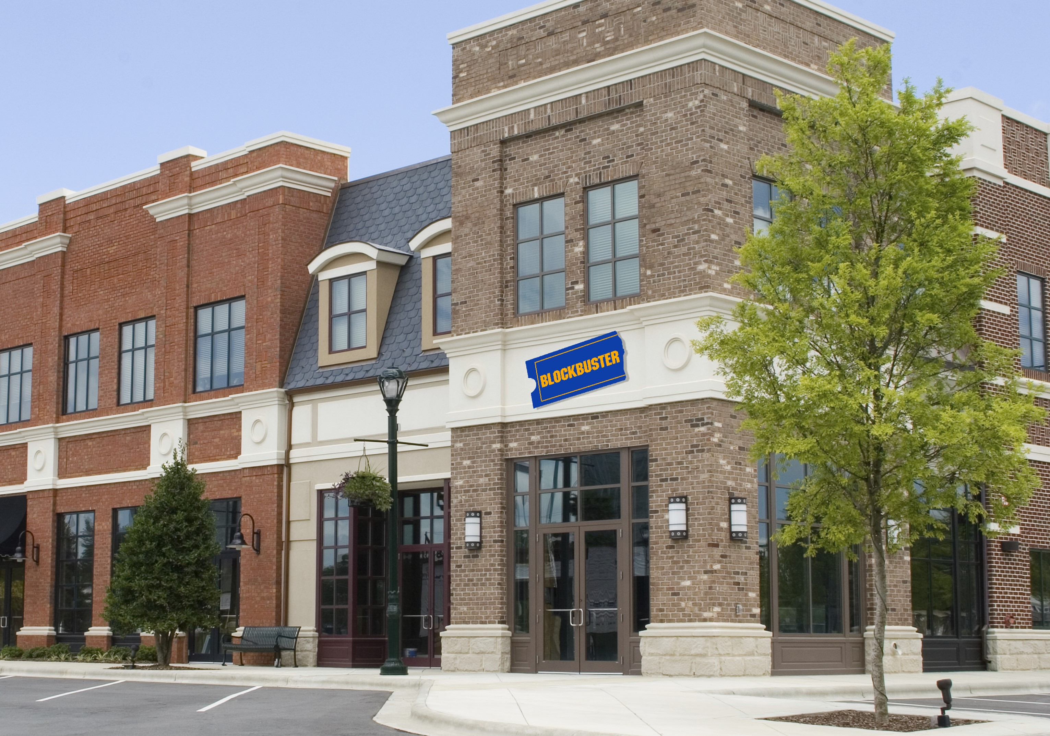








Slide 8
Our world is changing
Past
Long application cycles
Monolithic apps
Servers and VMs
Less data
Distinct infrastructure and operations teams
Today
Rapid innovation
Loosely-coupled apps and microservices
Serverless
Big Data
Service-focused DevOps teams
Servers
Services

Slide 9
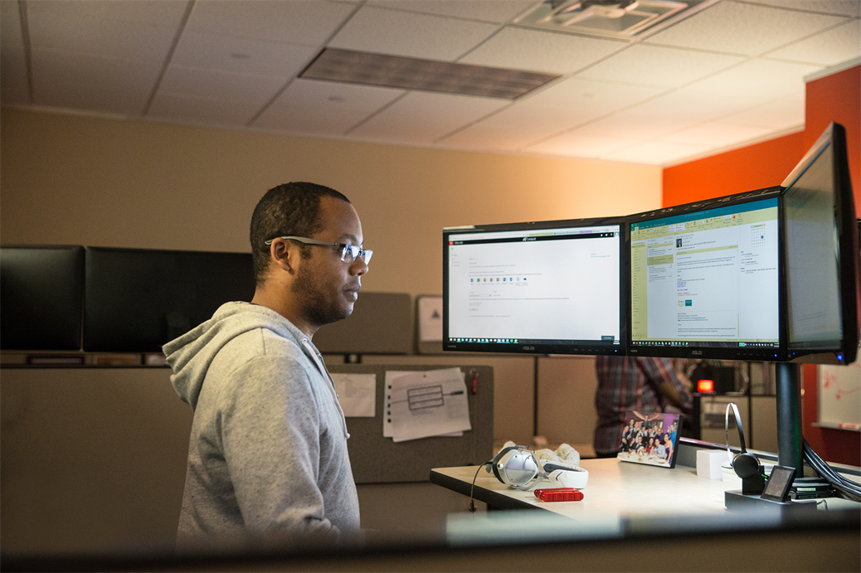
Where do developers spend time…
Maintaining existing applications
“Fixing” existing applications
Adding features to existing applications
Fixing the feature someone else added to the existing applications
Building a new application
(maybe … if there’s time)

Slide 10

Where do application admins spend time…
Maintaining existing applications
Re-deploying new versions
of existing applications
Diagnosing issues with
existing applications
Troubleshooting issues from feature additions to the existing applications
Deploying a new application

Slide 11

Help customers free resources and work more efficiently by modernizing traditional applications

Slide 12



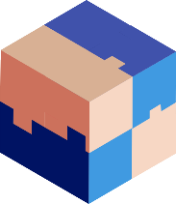



Ways to Modernize Applications
Lift & Shift
Modernize
Decompose
Transformed
Traditional application
Hosted as guest executables or containers in Kubernetes
Modernization by adding new microservices
Innovate by decomposing application into microservices
Transformed into microservices or new greenfield application
…You can stop at any stage

Slide 13


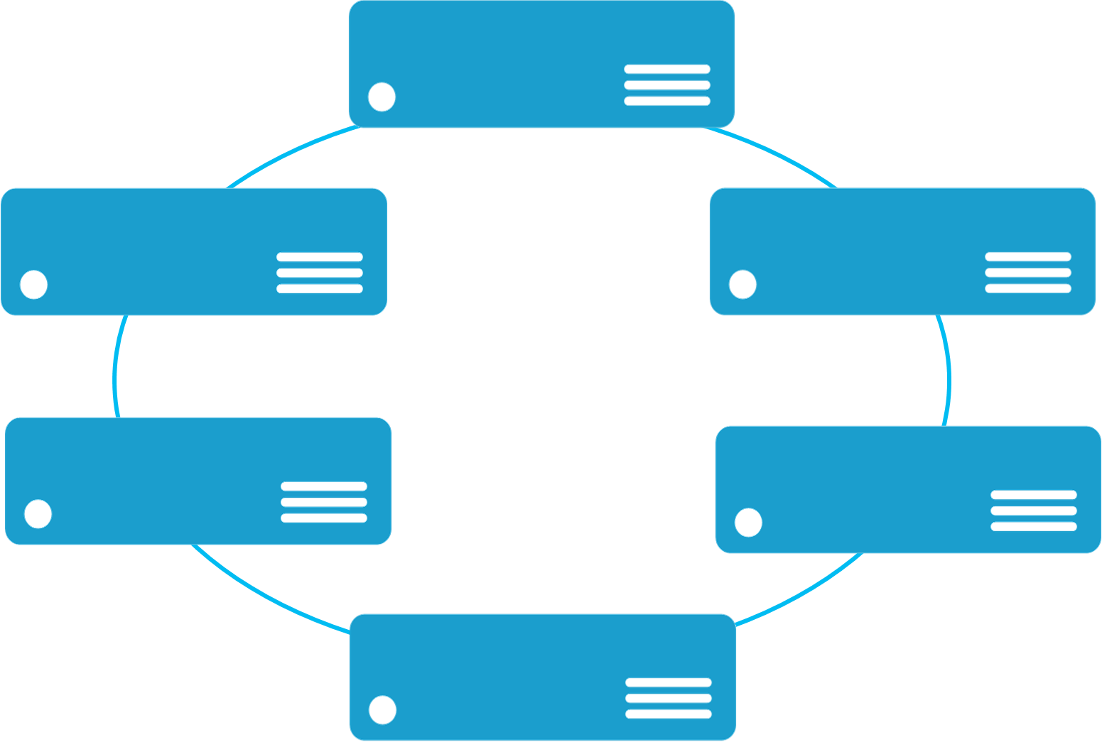


Monolithic application approach
Microservices application approach
A monolithic application has most of its functionality within a single process that is commonly componentized with libraries.
Monolith
A microservice application separates functionality into separate smaller services.
Microservices
Scales by cloning the app on multiple servers/VMs/Containers
Scales out by deploying each service independently creating instances of these services across servers/VMs/containers
State

Slide 14
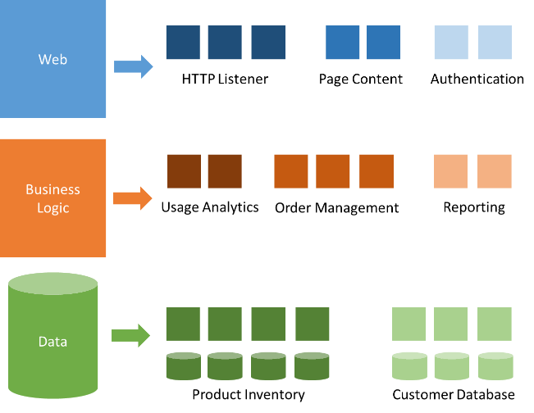
Modernization with microservices
Individually built and deployed
Small, independent services
Integrate using published API
Fine-grained, loosely coupled

Slide 15
Microservice architecture benefits
Scale Independently
Different Technology Stacks
Photo Share Service
Thumbnail Service
Photo Share Service node.js
Thumbnail Service .NET
Photo Share Service
Thumbnail Service
Photo Share Service
Thumbnail Service
Photo Share Service
Conflicting Dependencies
Independent Deployments
Photo Share Service
Photo Share Service V1
Thumbnail Service V1
SharedLib-v1
Thumbnail
Thumbnail Service V2
SharedLib-v7
Photo Share Service
Thumbnail Service
SharedLib-v1
SharedLib-v7

Slide 16
Microservices Benefits
Independent deployments
Enables continuous delivery
No downtime upgrades
Improved scale and resource utilization per service
Fault isolation
Security isolation
Services can be distributed across multiple servers or environments
Multiple languages / diversity
Smaller, focused teams
Code can be organized around business capabilities
Autonomous developer teams

Slide 17
Microservices – The Hard Part
Deployment is complex
Testing is difficult
Debugging is difficult
Monitoring/Logging is difficult
New service versions must support old/new API contracts
Distributed databases make transactions hard
Cluster and orchestration tools overhead
Distributed services adds more network communication
Increased network hops
Requires failure/recovery code
Need service discovery solution
Advanced DevOps capability: short-term pain for long-term gain

Slide 18
“Distributed apps are sufficiently complicated that they need to be flown by the instruments”

Slide 19
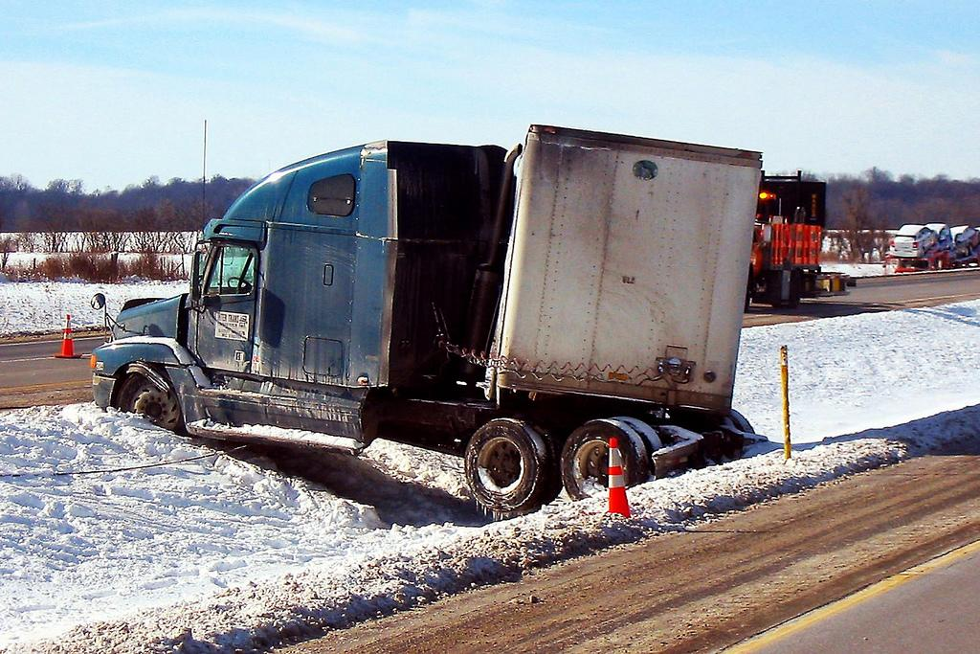
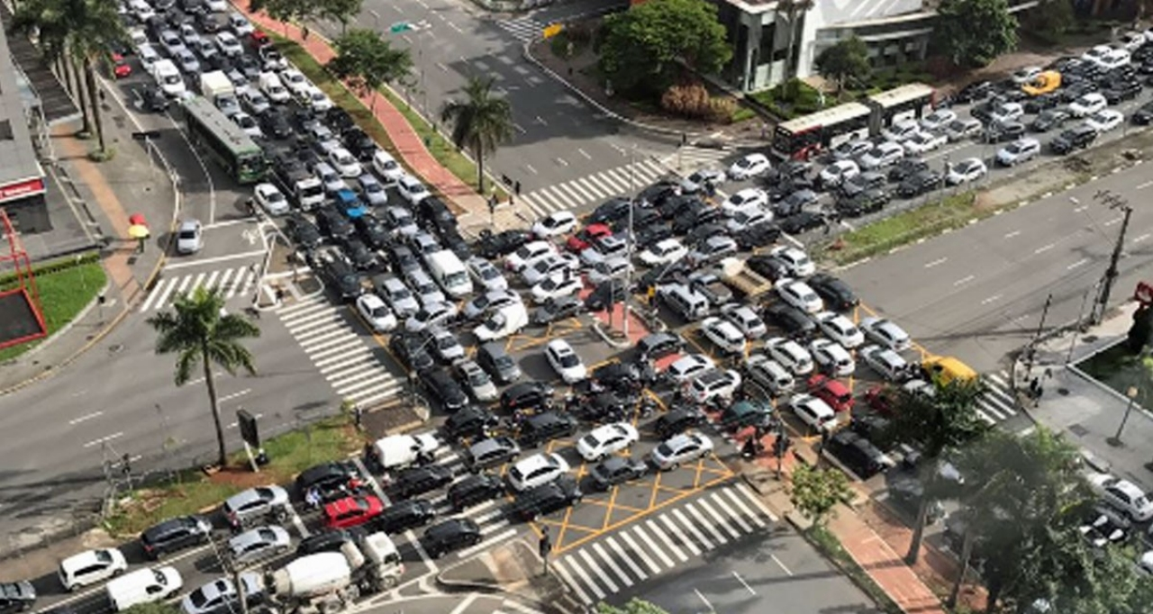

Slide 20
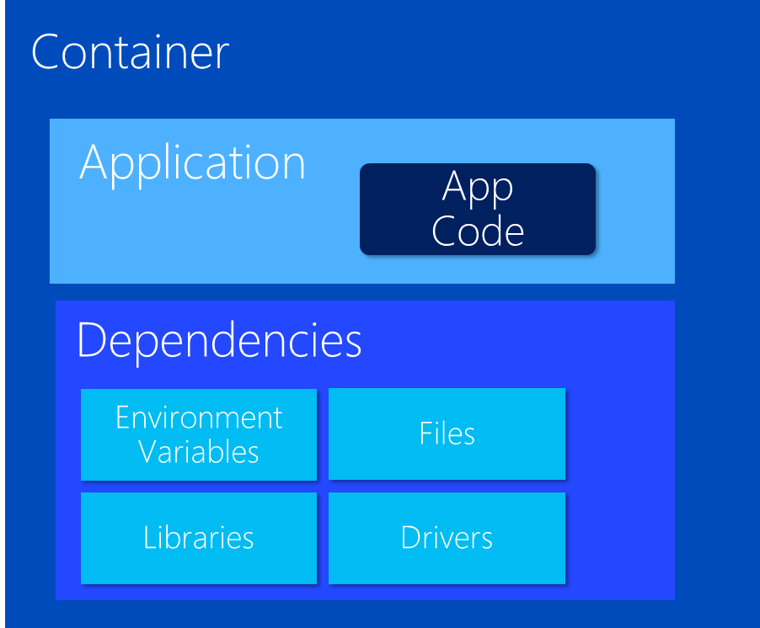
VM Host
VM Host
VM Host
VM Host
But things get
complicated quickly

Slide 21
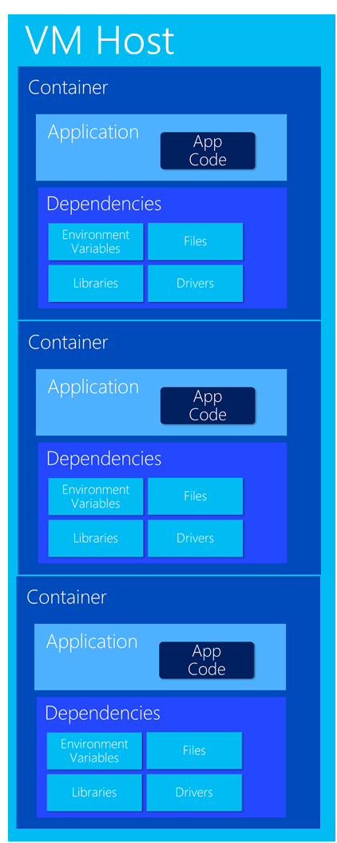
Very Quickly

Slide 22

What do cluster orchestrators do?
Provision
Security
Deploy (app / container)
Storage
Health Monitoring
Networking
Scaling
Service Discovery
Monitoring / Logging
Registry

Slide 23
Container Management at Scale
Cluster Management: deploy and manage cluster resources
Scheduling: where containers run
Lifecycle & Health: keep containers running despite failure
Naming & Discovery: where are my containers
Load Balancing: evenly distribute traffic
Scaling: make sets of containers elastic in number
Image repository: centralized, secure Docker container images
Continuous Delivery: CI/CD pipeline and workflow
Logging & Monitoring: track what’s happening in containers and cluster
Storage volumes: persistent data for containers

Slide 24
Orchestrator Ecosystem (Constantly Changing)
Cloud services
Azure Container Services (AKS, ACS)
Azure Service Fabric (ASF)
Amazon EC2 Container Services (ECS)
Google Kubernetes Engine (GKE)
Heroku
Tutum
Complete platforms
Kubernetes
Red Hat OpenShift (OCP)
Cloud Foundry
Mesosphere (Marathon)
Enterprise DC/OS
Docker Enterprise
Rancher
Low-level
Docker Swarm
CoreOS Fleet

Slide 25
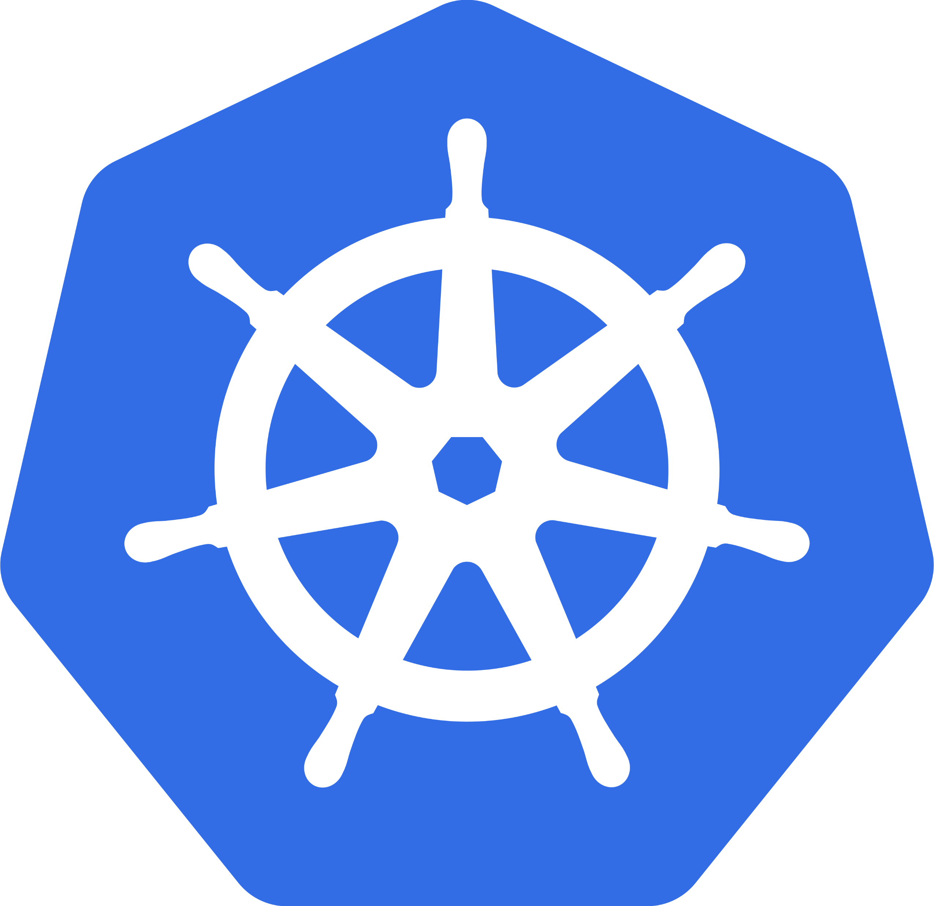
Why Kubernetes (K8s)?
Industry Momentum
It’s Microsoft’s Direction
It’s Docker’s Direction
It’s OCP’s Direction
It’s Cloud Foundry’s Direction
Brendan Burns
One of the Founders of K8s
Now works at MS heading up Container Strategies

Slide 26
What is Kubernetes?
History
Google open sourced borg. Google still actively involved, but less so every day
Schedules and runs application containers across a cluster of machines
Kubernetes v1.0 released on July 21, 2015. Joe Beda, Brendan Burns, & Craig McLuckie
Over 1,700 authors
Key features
Declarative infrastructure
Self-healing
Horizontal scaling
Automated rollouts and rollbacks
Service discovery and load balancing
Automatic binpacking
Storage orchestration
Secret and configuration management
Not a PaaS platform

Slide 27
Kubernetes Architecture

Slide 28
Kubernetes Architecture Components
api-server
etcd
master components
controller-manager
scheduler
kubelet
kube-proxy
node components
docker
dns

Slide 29
Master Components
api-server: Front-end control plane. Exposes API
etcd: Cluster database. Distributed, highly available
controller-manager. Runs controllers, eg. replication controller, node controller
scheduler: assigns pods to nodes
Add-ons
DNS
Heapster. enables monitoring and performance analysis
Dashboard
Logging
Notes:
Api-server
Many different flags or switches to configure
REST interface
Etcd
Distributed, highly available key store
Written and maintained by CoreOS
Raft consensus algorithm
watches, keys, values
etcd3 standard beginning with Kubernetes 1.6
Scheduler: “Policy-rich, topology-aware, workload-specific function that significantly impacts availability, performance, and capacity”

Slide 30
Worker Node Components
kubelet:
Primary node agent
Watches and runs assigned pods
Executes health probes and reports status
kube-proxy: enables network services
docker: container engine (rkt supported experimentally)

Slide 31
kubectl: CLI to run commands against a Kubernetes cluster
Swiss Army Knife: run deployments, exec into containers, view logs, etc.
Syntax largely the same as docker
Pronounced “koob sea tee el”…
Or “koob cuddle”
Notes:
Borg: The first unified container-management system developed at Google
It was built to manage both long-running services and batch jobs

Slide 32
Kubernetes Resources
pod
deployment
service
replica set
ingress
daemon set, job
namespace
secret, config-map

Slide 33
Kubernetes Resources
pod
deployment
service
namespace

Slide 34
What is a pod?
Pod is the basic building block in kubernetes
Pods are how containers are delivered
Can be multiple containers (eg - side car)
Encapsulates container(s), storage, network IP, and options on how to run
Use Deployment resources to deploy
ReplicaSet
StatefulSet
DaemonSet
Job
InitContainer

Slide 35
Deployment
Provides declarative updates for Pods and Replica Sets
Deployment describes ”desired state”
Can:
Create deployment to rollout ReplicaSet
Declare new state for pods (eg – new imageTag)
Rollback to earlier state
Scale up/down
Check rollout history
Clean-up

Slide 36
Kubernetes Services
Defines a logical set of pods (your microservice)
Essentially a virtual load balancer in front of pods

Slide 37
Kubernetes manifest: Pod
apiVersion: v1
kind: Pod
metadata:
name: redis-django
labels:
app: web
spec:
containers:
- name: key-value-store
image: redis
ports:
- containerPort: 6379
- name: frontend
image: django
ports:
- containerPort: 8000
Notes:
Borg: The first unified container-management system developed at Google
It was built to manage both long-running services and batch jobs

Slide 38
Interact with pods
$ kubectl get po --all-namespaces
$ kubectl describe po/my-pod
$ kubectl logs my-pod
# Run bash in container
$ kubectl exec -it my-pod bash

Slide 39
Kubernetes manifest: Deployment
apiVersion: apps/v1beta1
kind: Deployment
metadata:
name: smackweb-deploy
spec:
replicas: 5
template:
metadata:
labels:
app: smackweb
spec:
containers:
- name: smackweb
image: chzbrgr71/smackweb
ports:
- containerPort: 8080
Notes:
Borg: The first unified container-management system developed at Google
It was built to manage both long-running services and batch jobs

Slide 40
Service Types
ClusterIP:
Exposes the service on a cluster-internal IP. Choosing this value makes the service only reachable from within the cluster
NodePort:
Exposes the service on each Node’s IP at a static port (the NodePort)
Connect from outside the cluster by requesting <NodeIP>:<NodePort>
LoadBalancer:
Exposes the service externally using a cloud provider’s load balancer

Slide 41
Kubernetes manifest: Service
apiVersion: v1
kind: Service
metadata:
name: my-service
spec:
selector:
app: MyApp
type: ClusterIP
ports:
- protocol: TCP
port: 80
targetPort: 9376
Notes:
Borg: The first unified container-management system developed at Google
It was built to manage both long-running services and batch jobs

Slide 50
Namespaces
Allow for multiple virtual clusters backed by the same physical cluster
Logical separation
Namespace used in FQDN of Kubernetes services
Eg - <service-name>.<namespace-name>.svc.cluster.local
Every Kubernetes resource type is scoped to a namespace (except for nodes, persistentVolumes, etc.)
Intended for environments with many users, teams, projects

Slide 51
Labels and Selectors
Not related CSS…I promise
Labels are key/value pairs for any API object in Kubernetes
”Label selectors” == queries against labels to match objects
Use cases:
Associating pods to a service
Pinning workloads to specific nodes
Selecting a subset of resources

Slide 52
Networking

Slide 53
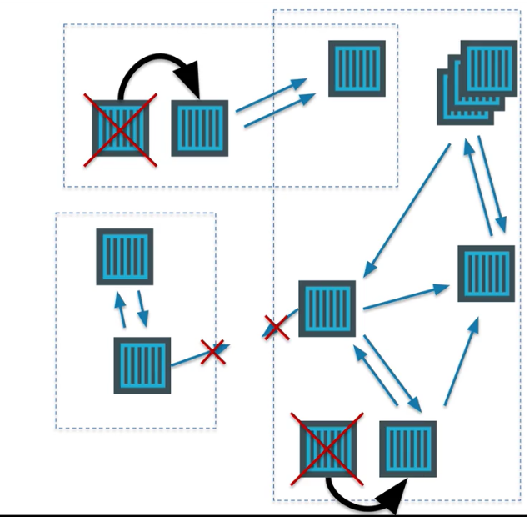
Networking in the Container World

Slide 54
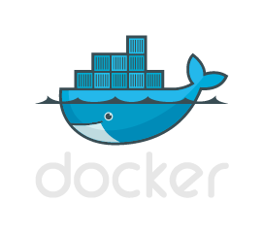

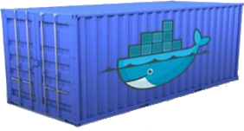
Multi-Host Networking
Agent1
Agent2
eth0 : 10.0.0.6
eth0 : 10.0.0.8
docker0 : 172.17.0.1
docker0 : 172.17.0.1
eth0 : 172.17.0.3
eth0 : 172.17.0.3
eth0 : 172.17.0.4
eth0 : 172.17.0.4
vethxxx
vethxxx
vethxxx
vethxxx

Slide 55




Multi-Host Networking
Agent1
key/value
store
Agent2
eth0 : 10.0.0.6
eth0 : 10.0.0.8
docker0 : 172.17.0.1
docker0 : 172.17.0.1
192.168.0.0/24
eth0 : 192.168.0.1
eth0 : 192.168.0.3
eth0 : 192.168.0.2
eth0 : 192.168.0.4
vethxxx
vethxxx
vethxxx
vethxxx

Slide 56
What is service discovery?
Problem: How service can find and communicate with another one running into the same cluster?
Service Registry/Naming Service
Service Announcement
Lookup/Discovery
Load Balancing
?!?

Slide 57
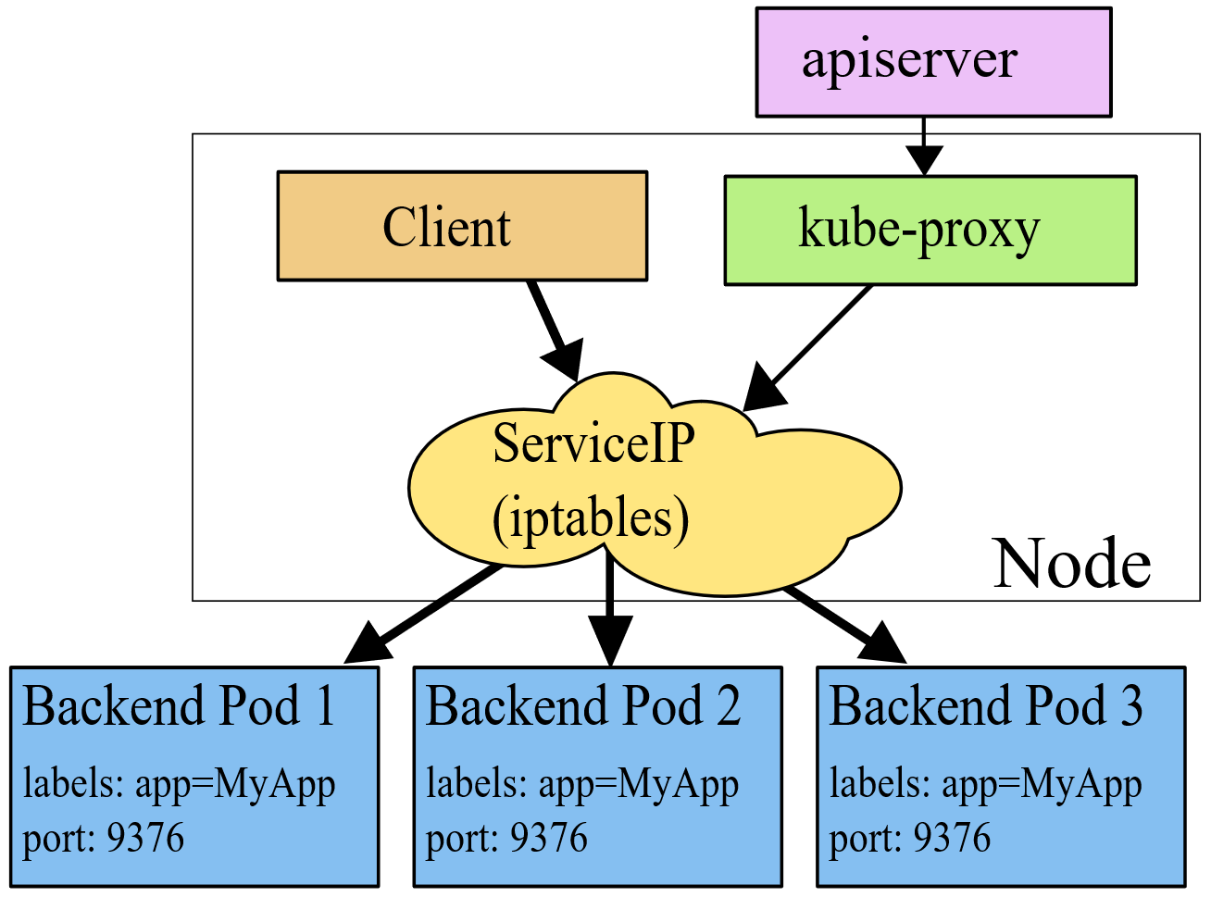
Networking in Kubernetes
Kubernetes Networking model introduces 3 methods of communications:
Pod-to-Pod communication directly by IP address. Kubernetes has a Pod-IP wide metric simplifying communication.
Pod-to-Service Communication – Client traffic is directed to service virtual IP by iptables rules that are modified by the kube-proxy process (running on all hosts) and directed to the correct Pod.
External-to-Internal Communication – external access is captured by an external load balancer which targets nodes in a cluster. The Pod-to-Service flow stays the same.
Notes:
When the backend Service is created, the Kubernetes master assigns a virtual IP address, for example 10.0.0.1. Assuming the Service port is 1234, the Service is observed by all of the kube-proxy instances in the cluster. When a proxy sees a new Service, it installs a series of iptables rules which redirect from the VIP to per-Service rules. The per-Service rules link to per-Endpoint rules which redirect (Destination NAT) to the backends.
When a client connects to the VIP the iptables rule kicks in. A backend is chosen (either based on session affinity or randomly) and packets are redirected to the backend. Unlike the userspace proxy, packets are never copied to userspace, the kube-proxy does not have to be running for the VIP to work, and the client IP is not altered.
This same basic flow executes when traffic comes in through a node-port or through a load-balancer, though in those cases the client IP does get altered.

Slide 58
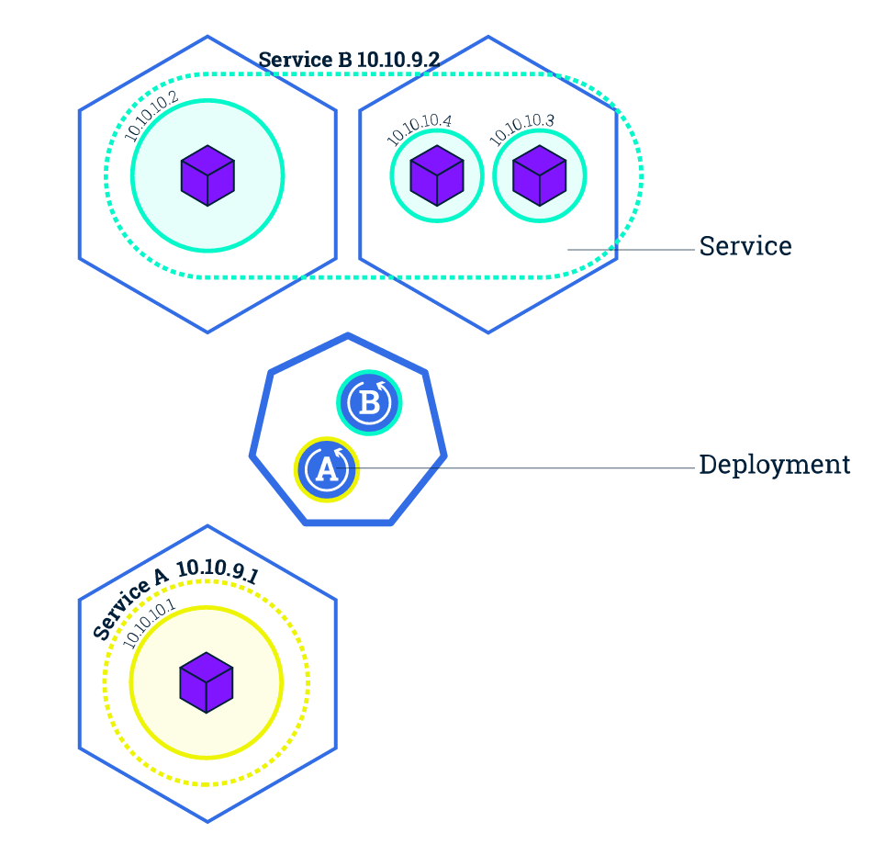
Service Discovery with Kubernetes
Nodes, Deployments, Pods, Services
Services
Expose the services
Works with platform Load Balancers to get public IPs
Internal load balancing between pods
kube-dns (preferred)
Name service enabled in Kubernetes (Default in ACS)
Environment Variables
Every Service is assigned environment variables with information of the service
REDIS_MASTER_SERVICE_HOST=10.0.0.11 REDIS_MASTER_SERVICE_PORT=6379 REDIS_MASTER_PORT=tcp://10.0.0.11:6379 REDIS_MASTER_PORT_6379_TCP=tcp://10.0.0.11:6379 REDIS_MASTER_PORT_6379_TCP_PROTO=tcp REDIS_MASTER_PORT_6379_TCP_PORT=6379 REDIS_MASTER_PORT_6379_TCP_ADDR=10.0.0.11
Source: https://kubernetes.io/docs/tutorials/kubernetes-basics/expose-intro/
Notes:
NOTE ON ENVIRONMENT VARIABLES: This does imply an ordering requirement - any Service that a Pod wants to access must be created before the Pod itself, or else the environment variables will not be populated. DNS does not have this restriction.

Slide 59
Ingresses
Typically, services and pods have IPs only routable by the cluster network
All traffic that ends up at an edge router is either dropped or forwarded elsewhere
Ingress is a collection of rules that allow inbound connections to reach the cluster services
An Ingress controller is responsible for fulfilling the Ingress, usually with a loadbalancer, though it may also configure your edge router or additional frontends to help handle the traffic in an HA manner
Notes:
I
Pods won’t survive scheduling failures, node failures, or other evictions, such as due to lack of resources, or in the case of node maintenance.

Slide 60
CNI
Add a slide on CNI here…
Notes:
I
Pods won’t survive scheduling failures, node failures, or other evictions, such as due to lack of resources, or in the case of node maintenance.

Slide 61
DevOps & CI / CD

Slide 62
DevOps Practices Arrive
Developers: Test, Build, Code, Plan
Operations: Monitor, Release, Deploy, Operate
DevOps Features
Speed of application delivery/updates
Faster time to value
Repeatable/consistent
Automated testing
Traceability of process
Applying developer patterns to infrastructure
Infrastructure as code
Ops teams embracing source control
Centralized monitoring, logging, debugging
CI / CD – key aspect of quality DevOps

Slide 63
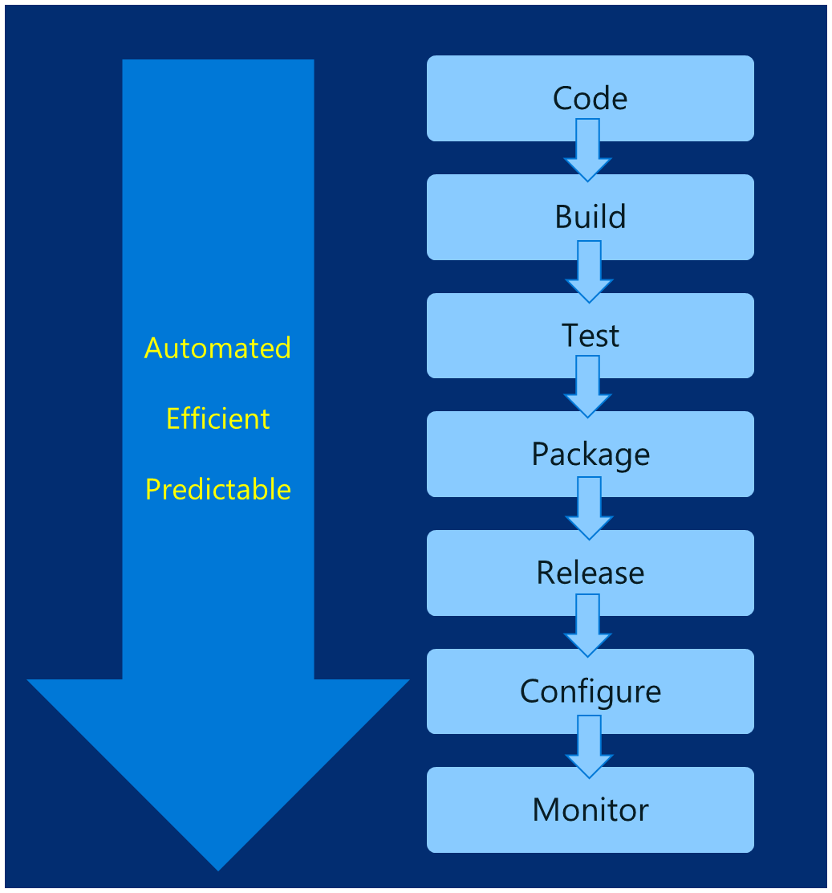
DevOps – Why you care
Deploy 200 times more frequently
Go from code check-in to production 2,555 times faster
Recover from failure 24 times faster
Spent 50% less time remediating security challenges
Spent 22% less time on unplanned work
2.2 times more likely to believe their places a great place to work
Source: https://puppet.com/resources/white-paper/2016-state-of-devops-report

Slide 64
Common Toolsets
Jenkins
Visual Studio Team Services
Spinnaker and Netflix OSS
Travis
TeamCity
CircleCI
Additional utilities: code quality scanning, security, collaboration, etc.

Slide 65
Helm: Kubernetes Package Manager

Slide 66
Birth of Helm
On October 15th, 2015
Hackathon project at company offsite
Could we take the ideas behind npm and Homebrew and build something for deploying apps into Kubernetes?
Installation tool for Deis Workflow
Announced at the first KubeCon in San Francisco 2015

Slide 67
Helm Charts
Application definition
Consists of:
Metadata
Kubernetes resource definitions
Configuration
Documentation
Stored in chart repository
Any HTTP server that can house YAML/tar files (Azure, GitHub pages, etc.)
Public repo with community supported charts (eg – Jenkins, Mongo, etc.)
Helm (CLI) + Tiller (server side)
Release: Instance of chart + values -> Kubernetes

Slide 69
Chart structure
Charts have structure
Set of conventions, including file and directory names
Charts can be packaged into tarballs for distribution

Slide 70
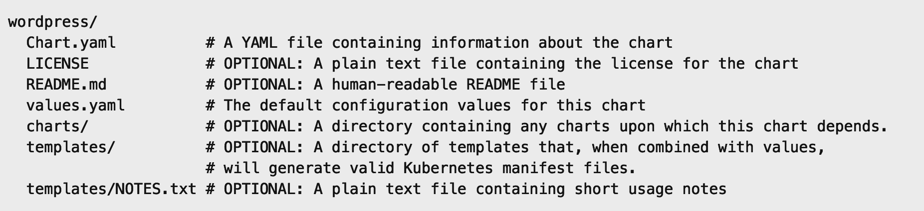
Chart structure
Layout
Helm expects a strict chart structure

Slide 71
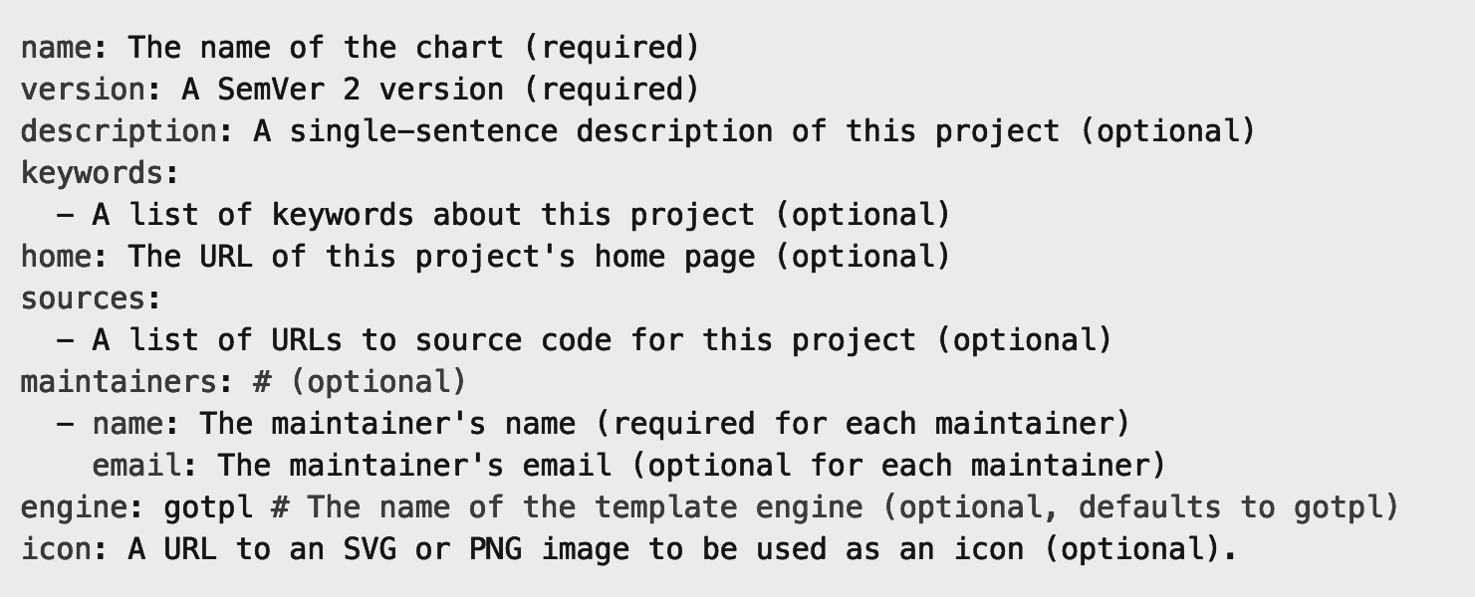
Chart.yaml

Slide 72
Helm values.yaml
The knobs and dials:
A values.yaml file provided with the chart that contains default values
Use -f to provide your own values overrides
Use --set to override individual values

Slide 73
Helm Templates
Built on Go’s template language w/addition of 50 or so add-on template functions
Almost anything goes! ;-)
Also useful in generating random values (e.g. passwords)
Provides flow control (if/else, with, range, etc)
Named templates (partials)

Slide 74
Draft: Streamlined Kubernetes Development
What is draft?
Developer workstations cannot mimic production
As devs hack on code prior to committing to version control
Draft targets the "inner loop" of a developer's workflow
Works with other Deis tools such as Helm and Workflow
Developer Workstation
Dev (Inner Loop)
Production / Staging Cluster

Slide 75
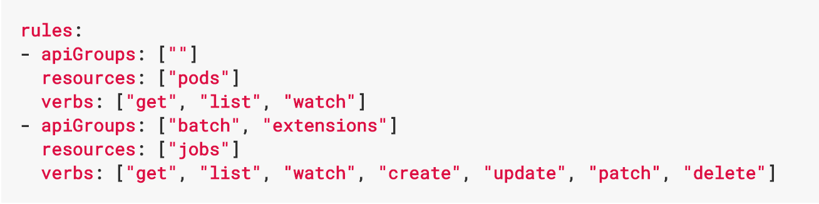
Role Based Access Control
Allows for dynamic policies against k8s API for authZ
In version 1.6, this is a beta feature
Can create both ”Roles” and “ClusterRoles”
Can configure api-server and kubectl to use Azure AD for access
To grant permissions:
Use ”RoleBindings” for within namespaces
Use “ClusterRoleBindings” for cluster-wide access
Can contain users, groups, service accounts
Control access to specific resources or API verbs

Slide 76
Application Health and Readiness
Kubelets on workers use liveness and readiness probes to know when to restart a container or start directing traffic
Liveness check: when to restart
Readiness check: when to forward Service traffic to a pod
Notes:
Look at liveness
Look at readiness

Slide 77
Monitoring: What indicators matter in Kubernetes
Cluster health: total number of nodes, pods, etc
Node health: available compute resources, health
Application health
Tooling Examples
Datadog
Prometheus
Cloud-specific: OMS (Azure), CloudWatch (AWS)

Slide 78
Logging
Pod logs: applications must log to standard out!
Cluster-wide event logs
Logging forwarder solutions
fluentd
logstash
Log indexers
OMS Log Analytics
Splunk
ELK stack

Slide 79
ConfigMaps and Secrets
Flexible configuration model for Kubernetes
Both Secrets and ConfigMaps can be used as ENV vars or files
Secrets
Use Secrets for things which are actually secret like API keys, credentials, etc
Secret values are base64 encoded and automatically decoded for pods
ConfigMaps
ConfigMaps for configuration that doesn’t have sensitive information. However, there are pros/cons with each
ConfigMaps designed to more conveniently support working with strings

Slide 80
DaemonSets
Ensures that all (or some) nodes run a copy of a pod
Doesn't care if a node is marked as unschedulable
Can make pods even if the scheduler is not running

Slide 81
StatefulSets
Used for workloads that require consistent, persistent hostnames e.g. etcd-01, etcd-02
One PersistentVolume storage per pod
StatefulSet example - zookeeper
StatefulSet example - cockroachdb

Slide 82
Jobs
Creates one or more pods and ensures that a specified number of them successfully terminate
3 types of jobs
Non-parallel Jobs - e.g. single pod done when exit is successful
Parallel Jobs with a fixed completion count - e.g. one successful pod for each value in the range 1 to .spec.completions
Parallel Jobs with a work queue that coordinate with each other and terminate when one pod exits successfully

Slide 83
Docker, Docker, Docker
Containers have been around for many years
Linux kernel: cgroups, namespaces
Docker Inc. did not invent them
They created open source software to build and manage containers
Docker makes containers easy
Super easy. Fast learning curve
Docker is a container format and a set of tools
Docker CLI, Docker Engine, Docker Swarm, Docker Compose, Docker Machine

Slide 84
What is a container?
Slice up the OS to run multiple apps on a single VM
Every container has an isolated view and gets
it’s own file system
it’s own PID0 and eth0 network interface
Container and apps share lifecycle
Shared kernel, very fast start-up, and repeatable execution
Cannot mix OS
VM/Host
Container: App-A:v1
Container: App-B:v3
Container: App-A:v2
App-A v1
App-B v3
App-A v2
Lib-L v2
Lib-L v3
Lib-L v3
Lib-M v2
Runtime v5
Runtime v7
Runtime v6
Notes:
- Encapsulation of Dependencies (Environment Variables, Files, Libraries and Drivers)

Slide 85

How Containers Work
Containers
Windows Server containers No different from Linux containers
= Operating system virtualization
Container
Container
Container
Container
Container
Container
Application
OS
Hardware
Windows Server
Traditional virtual machines = hardware virtualization
Hyper-V containers Isolation plus performance
Application
VM
VM
VM
Container
Container
Container
OS
Hardware
WS
WS
WS
Hyper-V

Slide 86
Docker vs VMs

Slide 87
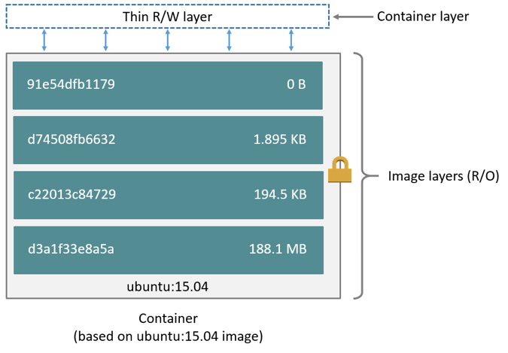
Docker Container Anatomy
Image source: https://docs.docker.com/engine/userguide/storagedriver/imagesandcontainers/#images-and-layers

Slide 88
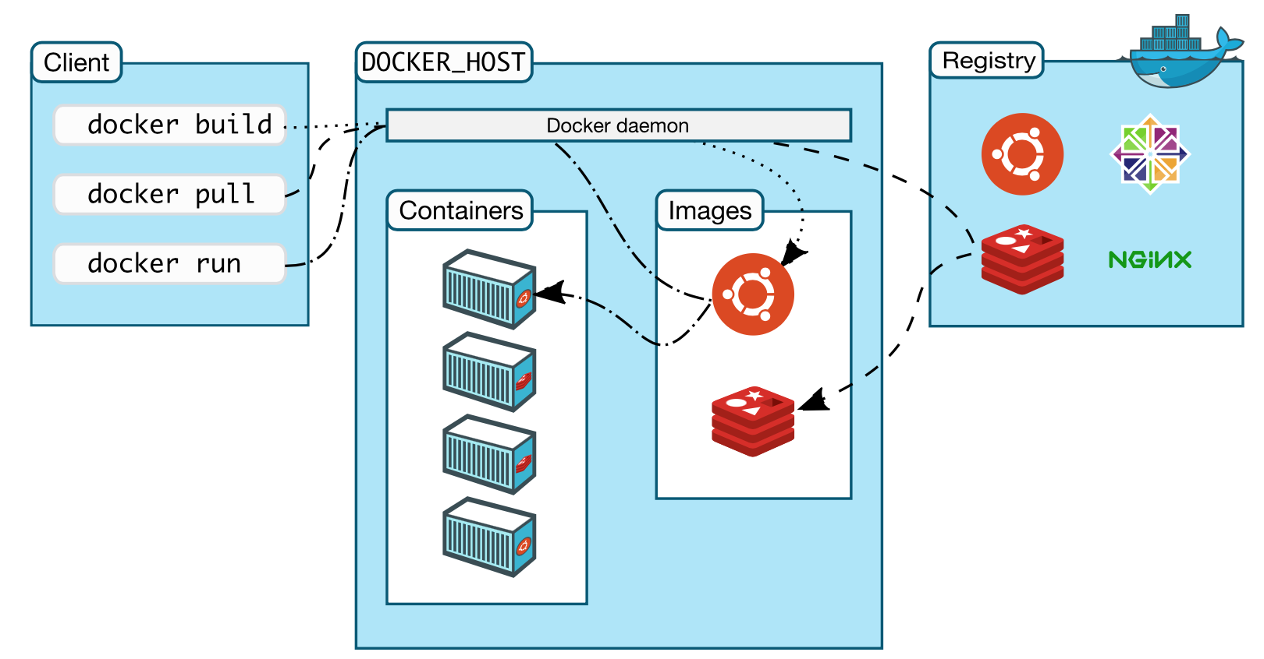
Docker architecture

Slide 89
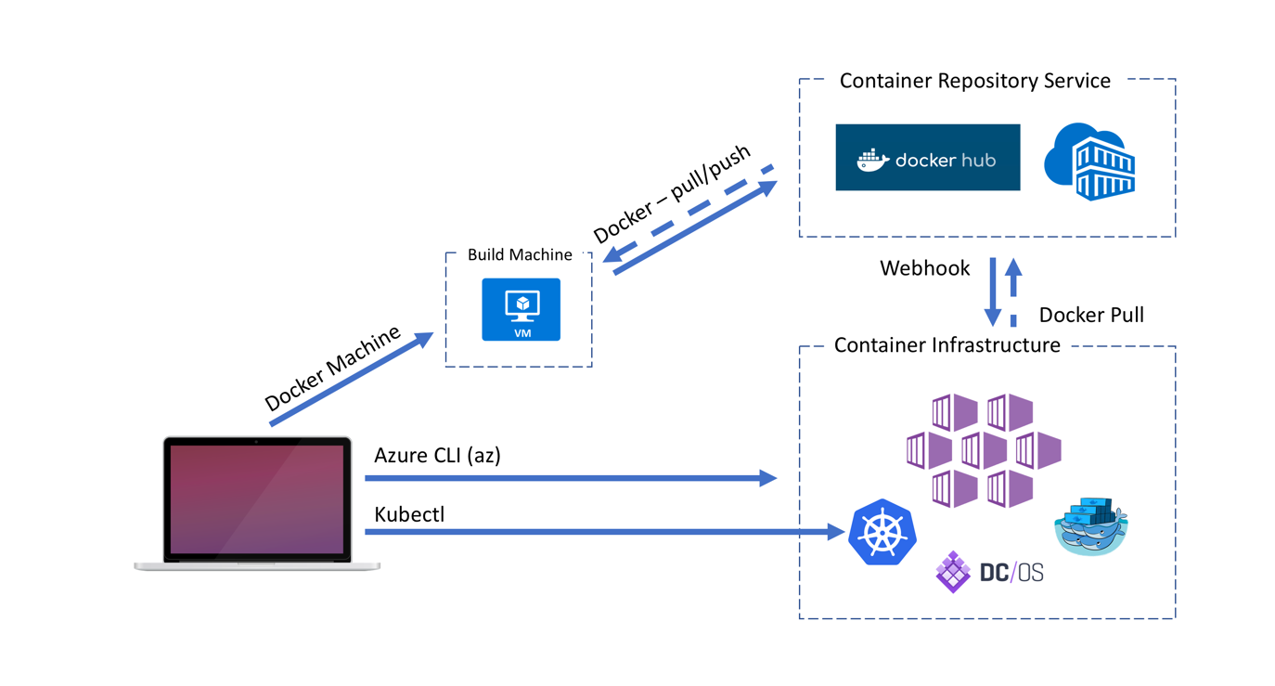
Docker architecture

Slide 90
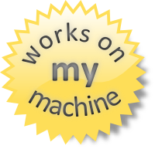
Why containers?
Repeatable execution
immutable environment
reusable and portable code (“Build, Ship, and Run”)
Consistency across development, test, & production
Fast & agile app deployment; instant startup
Cloud portability
Density, partitioning, scale
Diverse developer framework support
Microservices

Slide 92
12-Factor Apps
http://12factor.net

Slide 93
12-Factor Apps (1-5)
Single root repo; don’t share code with another app
Deploy dependent libs with app
No config in code; read from environment vars
Handle unresponsive app dependencies robustly
Strictly separate build, release, & run steps
Build: Builds a version of the code repo & gathers dependencies
Release: Combines build with config ReleaseId (immutable)
Run: Runs app in execution environment
Notes:
Single root repo; don’t share code with another app
Deploy dependent libs with app
No config in code; read from environment vars
Handle unresponsive app dependencies robustly
Strictly separate build, release, & run steps
Build: Builds a version of the code repo & gathers dependencies
Release: Combines build with config → ReleaseId (immutable)
Run: Runs app in execution environment

Slide 94
12-Factor Apps (6-12)
App executes as 1+ stateless process & shares nothing
App listens on ports; avoid using (web) host
Use processes for isolation; multiple for concurrency
Processes can crash/be killed quickly & start fast
Keep dev, staging, & prod environments similar
Log to stdout (dev=console; prod=file & archived)
Deploy & run admin tasks (scripts) as processes
Notes:
App executes as 1+ stateless process & shares nothing
App listens on ports; avoid using (web) host
Use processes for isolation; multiple for concurrency
Processes can crash/be killed quickly & start fast
Keep dev, staging, & prod environments similar
Log to stdout (dev=console; prod=file & archived)
Deploy & run admin tasks (scripts) as processes

Slide 95

Questions?

